Slide 1

Data Structure and Algorithms
Instructor: Rafia Shaikh

Slide 2
Java Basics
Lecture # 01

Slide 3
What is JAVA?
Java is a programming language and computing platform first released by Sun Microsystems in 1995.
Object-oriented programming language.
Java is an interpreted language.

Slide 4
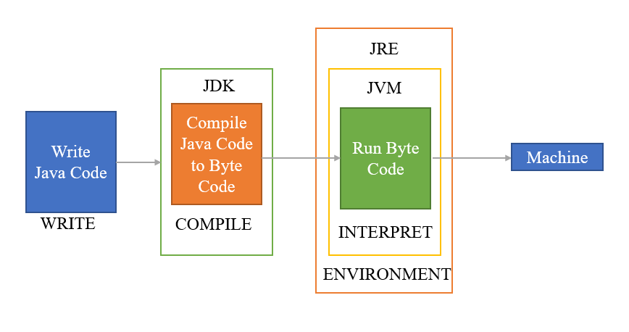
Runtime Architecture
Notes:
Java is an interpreted language
Compiles to byte instead of machine language
Applications are portal between platforms without recompiling

Slide 5
Tools
JDK
Visual Studio Code

Slide 6

First Program in Java – Hello World

Slide 7
Thank you
Happy Coding ☺

Slide 8
References
Java 11 + Essential Training (LinkedIn course)
https://devaraj-durairaj.medium.com/java-architecture-and-components-febd83b3adfc

